Slide 1









Subtopic N2.1 - Properties of Addition and Subtraction
LEARNING OUTCOME: To understand the properties of addition and subtraction.
Keywords:
Addition
Subtraction
Sum
Difference
Objectives:
To visually represent addition and subtraction.
To use bar models to write additions and subtractions.
Introduction – Read and annotate:
In this topic, you will use bar models and fact families to recall addition and subtraction facts. Fact
families show how numbers are connected and can be rearranged to form related number sentences.
Definition
Characteristics
The sum of two or more numbers.
We can add with integers, decimals, fractions and many other types of number.
Addition is commutative, e.g. 5 + 6 = 6 + 5
Examples
Addition
Non - Examples
4 + 4 = 8
10 - 5 = 5
+
+
+
+
+
+
+
+
Addition facts using bar models
Example 1 - I do | Example 2 - We do | Example 3 - You do…
Write the addition facts from the bar models given
12
12
12
6
6
4
8
2
10
6
6
12
4
8
12
2
10
12
6
6
12
8
4
12
10
2
12
Independent Practice.
1. Write the addition facts from the bar model given
Question | Bar Model | Addition Facts
a)
b)
10
4
6
10
4
6
6
4
10
10
7
3
10
7
3
3
7
10

Slide 2

Question | Bar Model | Addition Facts
c)
d)
e)
f)
g)
h)
i)
j)
k)
10
8
2
10
8
2
2
8
10
10
9
1
11
9
1
1
9
11
14
10
4
14
10
4
4
10
14
14
9
5
14
9
5
5
9
14
14
6
8
14
6
8
8
6
14
16
10
6
16
10
6
6
10
16
16
5
11
16
5
11
11
5
16
17
9
8
17
9
8
8
9
17
19
13
6
19
13
6
6
13
19

Slide 3
Question | Bar Model | Addition Facts
l)
m)
n)
o)
p)
q)
r)
s)
t)
20
10
10
20
10
10
10
10
20
20
15
5
20
15
5
5
15
20
20
14
6
20
14
6
6
14
20
22
12
10
22
12
10
10
12
22
24
4
20
24
4
20
20
4
24
28
16
12
28
16
12
12
16
28
28
15
13
28
15
13
13
15
28
30
20
10
30
20
10
10
20
30
35
20
15
35
20
15
15
20
35

Slide 4


Definition
Characteristics
The difference between two or more numbers.
We can subtract with integers, decimals, fractions and many other types of number.
Subtraction is not commutative, e.g. 6 - 5 is not equal to 5 – 6.
Subtraction
Examples
Non - Examples
8 - 4 = 4
5 - 10 = 5
This is a non-example because 5 – 10 = -5.
+
+
+
+
+
+
+
+
Subtraction facts using bar models
Example 4 - I do | Example 5 - We do | Example 6 - You do…
Write the subtraction facts from the bar models given
12
12
12
6
6
4
8
2
10
12
6
6
12
4
8
12
2
10
12
6
6
12
8
4
12
10
2
Independent Practice.
2) Write the subtraction facts from the bar models given
Question | Bar Model | Subtraction Facts
a)
b)
c)
3
3
1
2
1
2
3
2
1
4
4
3
1
3
1
4
1
3
6
6
2
4
2
4
6
4
2

Slide 5


Question | Bar Model | Subtraction Facts
d)
e)
f)
g)
h)
i)
j)
k)
8
8
2
10
2
6
2
8
10
9
9
1
11
4
5
1
9
11
10
4
14
10
4
10
14
4
6
9
5
14
10
5
9
14
7
3
10
10
6
16
8
2
6
10
16
10
5
11
16
9
1
11
5
16
11
9
8
17
9
2
8
9
17
12
13
6
19
10
2
6
13
19

Slide 6


Question | Bar Model | Subtraction Facts
l)
m)
n)
o)
p)
q)
r)
s)
t)
12
12
7
5
7
5
12
5
7
13
13
5
8
5
8
13
8
5
14
14
10
4
10
4
14
4
10
14
14
9
5
9
5
14
5
9
14
14
6
8
6
8
14
8
6
16
16
10
6
10
6
16
6
10
16
16
5
11
5
11
16
11
5
17
17
9
8
9
8
17
8
9
19
19
13
6
13
6
19
6
13

Slide 7
Question | Bar Model | Subtraction Facts
u)
v)
w)
x)
y)
z)
a1)
b1)
c1)
20
20
10
10
10
10
20
10
10
20
15
5
20
15
5
20
5
15
20
20
14
6
14
6
20
6
14
22
22
12
10
12
10
22
10
12
24
24
20
4
4
20
24
4
20
28
28
16
12
16
12
28
12
16
28
28
15
13
15
13
28
13
15
30
30
20
10
20
10
30
10
20
35
35
20
15
20
15
35
15
20

Slide 8
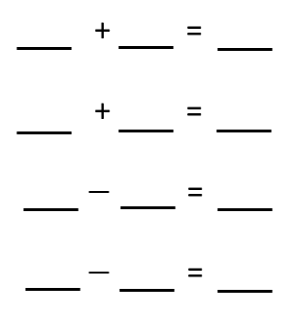
Fact families from bar models
Example 7 - I do | Example 8 - We do | Example 9 - You do…
Write the number families from the bar models given
10
20
34
5
5
4
16
8
26
5
5
10
4
16
20
8
26
34
5
5
10
16
4
20
26
8
34
10
5
5
20
16
4
34
8
26
10
5
5
20
4
16
34
26
8
Independent Practice.
3. Write the number families from the bar models given
a)
10
b)
10
c)
10
d)
10
4
6
5
5
1
9
8
2
4 6 10
5 5 10
1 9 10
8 2 10
6 4 10
5 5 10
9 1 10
2 8 10
10 4 6
10 5 5
10 1 9
10 8 2
10 6 4
10 5 5
10 9 1
10 2 8
e)
f)
8
g)
h)
7
6
9
3
4
4
4
4
2
4
5
3 4 7
4 4 8
4 2 6
4 5 9
4 3 7
4 4 8
2 4 6
5 4 9
7 3 4
8 4 4
6 4 2
9 4 5
7 4 3
8 4 4
6 2 4
9 5 4

Slide 9
i)
j)
k)
l)
12
12
11
16
10
2
5
7
3
8
10
6
10 2 12
5 7 12
3 8 11
10 6 16
2 10 12
7 5 12
8 3 11
6 10 16
12 10 2
12 5 7
11 3 8
16 10 6
12 2 10
12 7 5
11 8 3
16 6 10
m)
n)
o)
p)
20
20
20
20
12
8
15
5
4
16
7
13
12 8 20
15 5 20
4 16 20
7 13 20
8 12 20
5 15 20
16 4 20
13 7 20
20 12 8
20 15 5
20 4 16
20 7 13
20 8 12
20 5 15
20 16 4
20 13 7
q)
r)
18
s)
t)
22
25
30
4
18
6
12
13
12
8
22
4 18 22
6 12 18
13 12 25
8 22 30
18 4 22
12 6 18
12 13 25
22 8 30
22 4 18
18 6 12
25 13 12
30 8 22
22 18 4
18 12 6
25 12 13
30 22 8

Slide 10
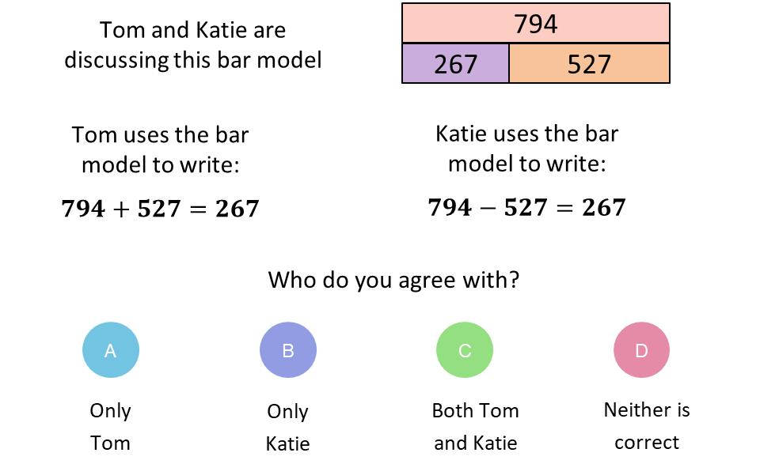

Skills Check
1.
2.
7
7
3
4
3
4
Write both addition facts from this bar model
Write both subtraction facts from this bar model
3
4
7
7
3
4
4
3
7
7
4
3
3. Which calculation is missing from the number
family?
4.
5 + 6 = 11
6 + 5 = 11
11 – 6 = 5
11 – 5 = 6
b) 6 – 11 = 5
c) 5 – 6 = 11
d) 5 – 11 = 5

